Slide 1
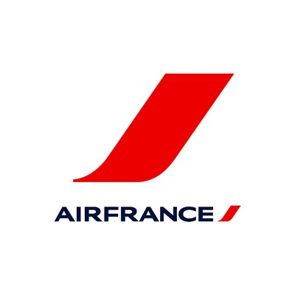
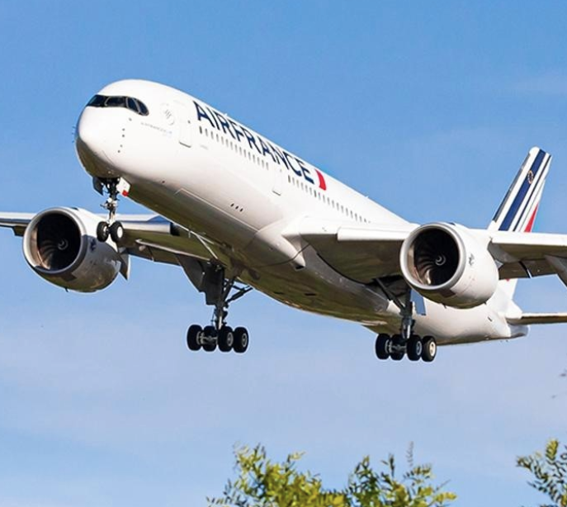
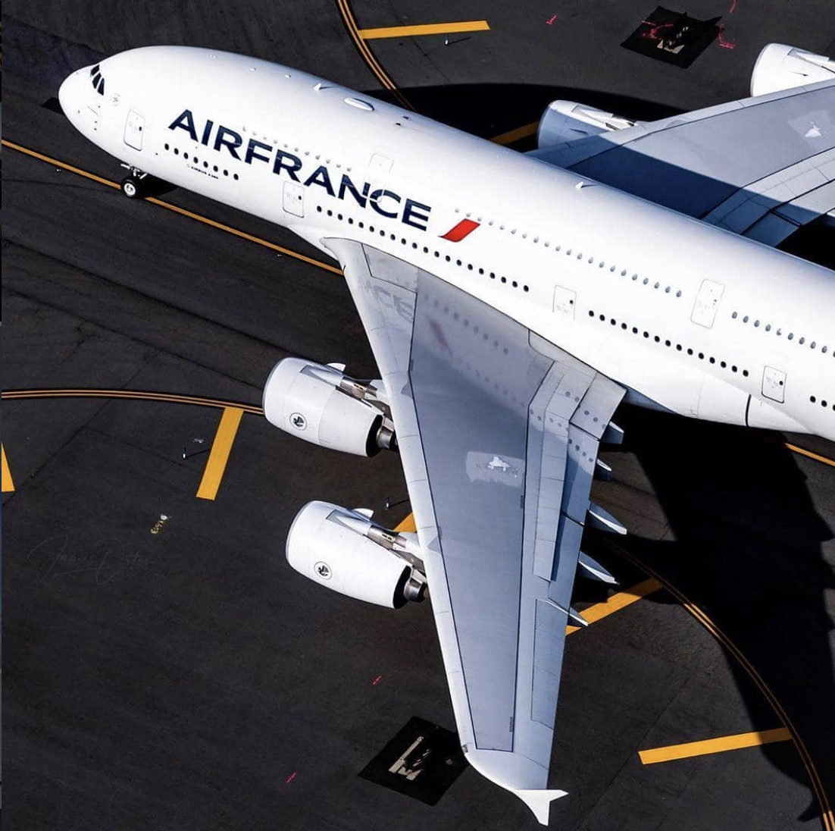
Air France Business Case
Fernando Patron
Mengting Lin
Alessandro Bruni Conter
Sneha Ramu

Slide 2




Mengting Lin
Alessandro Bruni Conter
Meet Our Team
Fernando Patron
Sneha Ramu

Slide 3

Agenda
Executive Summary
Case Analysis
Search Engine Marketing
Analysis
Marketing Campaign
Publisher
Keyword
RoA
Predictive analysis
Recommendations & Next Steps
Appendix

Slide 4
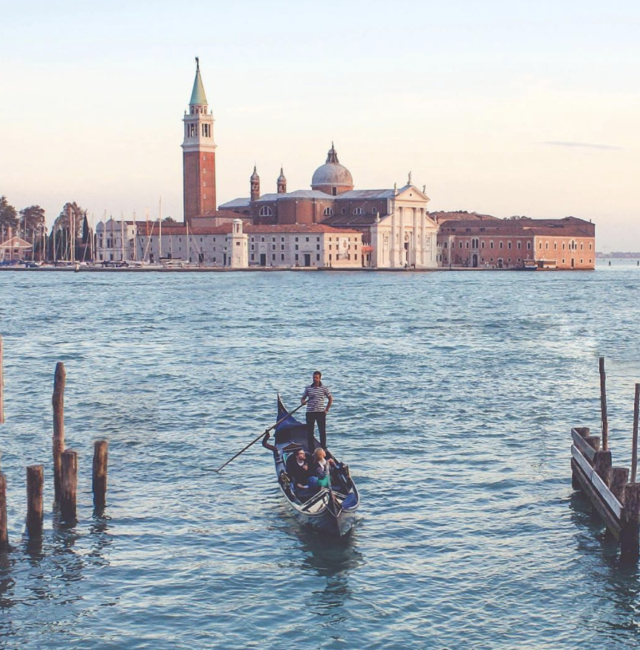

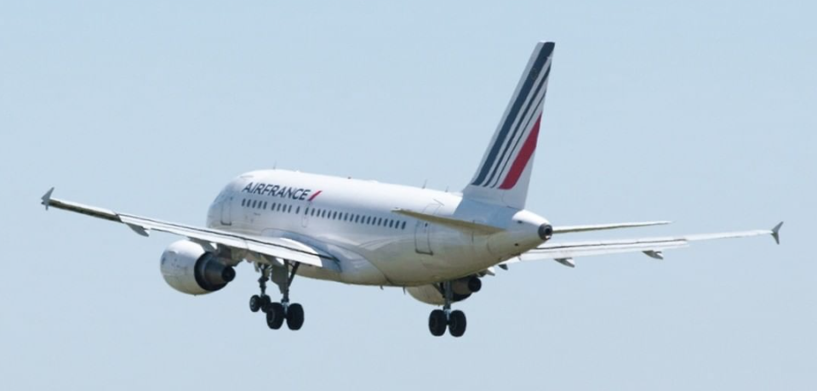
Executive Summary
Challenge
Which of the search engines are the ones that give the most return on investment to Air France.
Which strategy is the most efficient and the one that gives the best performance.
Insights
Our priority is to determine which Search Engine Marketing gives the best ROA, CTR and Conversion Rate.
Which Keyword strategy has the best performance (branded or unbranded)
Recommendations
Invest advertising budget to Yahoo-US and Google-US in match types of “Advanced” and “Broad” keywords.
Reduce expenses in “Impressions”.
Relocate the budget from Overture to Yahoo-US and Google-US.
Notes:
Challenge:
In this analysis the main objective is to determine which of all the search engines are the ones that perform the best in terms of return on investment or ROA.
Also we will analyze which marketing strategy is the most efficient one and has the best results.
Insights
The main aspects to consider from this analysis is which search engine marketing have better KPI’s (such as ROA, CTR, or Conversion Rate)
Also, we need to find in terms of keyword strategy, what’s the most efficient one. Either branded or unbranded.
Recommendations:

Slide 5

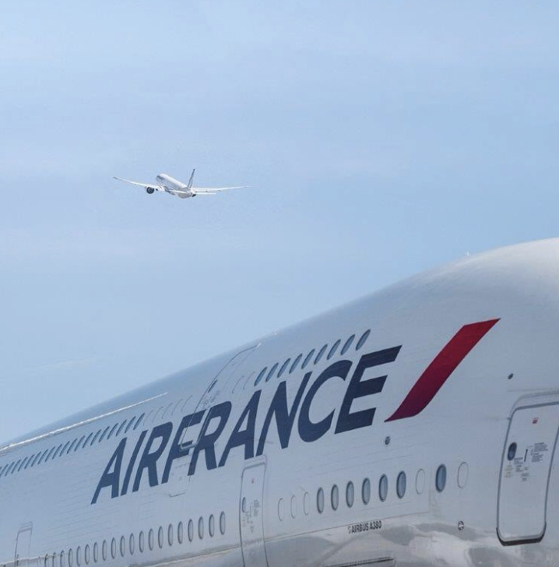

Case Analysis
Air France
Air France is the national airline of France, owned by the Air France-KLM group.
Formed in 1933 by the merger of the five major French airlines of the time.
Formerly publicity owned, then it was partially converted to private in 1990
Air France’s business is divided into three main segments: passenger transport, cargo, assistance and maintenance.
Business Case
Media Contacts is digital marketing agency, and it acts as an intermediary between Air France and digital media.
It promotes Air France advertising on web sites and monitoring the results, it draws conclusions about the most effective strategy
Notes:
3) following its integration with KLM. The government’s intention was to create a unified national air carrier with economies of scale and global scope to counter the potential threats arising from the liberalization of the European air transport market.

Slide 6
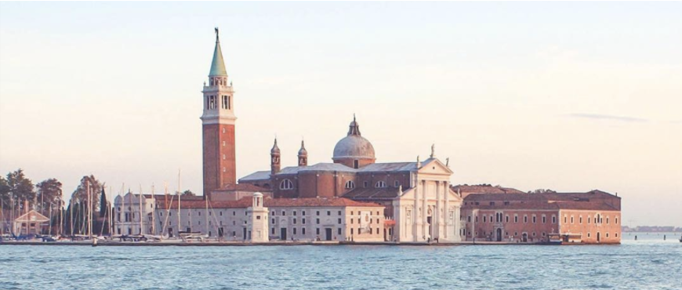



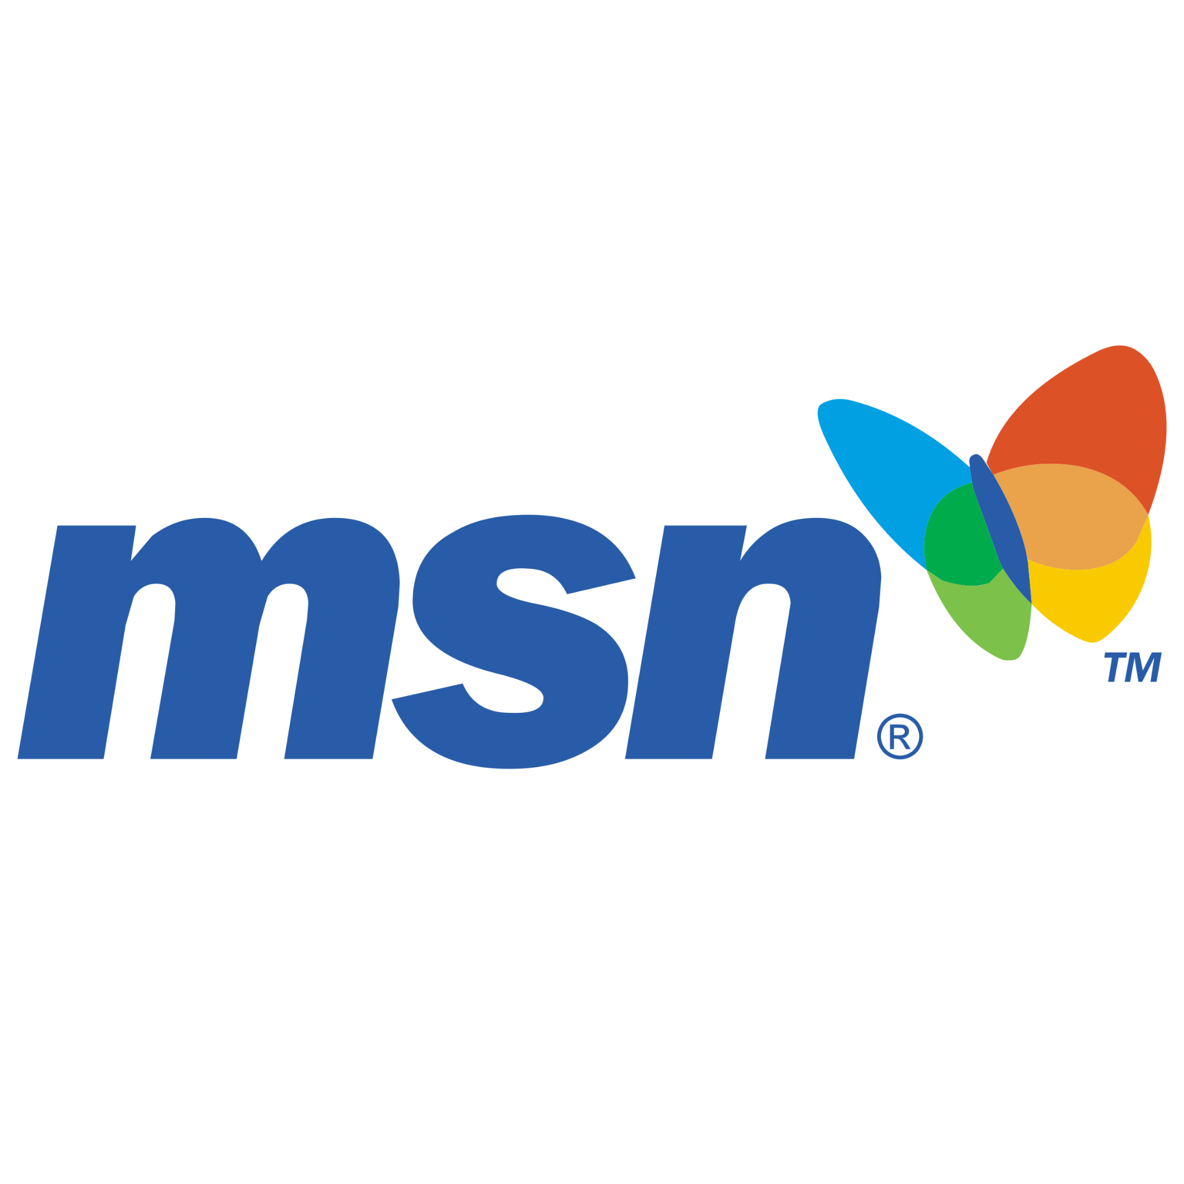
Search Engine Marketing
SEM is a marketing strategy to increase the presence of a brand in a website or search engine results.
Notes:
Before we begin our analysis we need to define what is SEM.
Which basically is a marketing strategy that helps a brand increase its presence in a search result and then this may be translated into clicks or potential bookings.

Slide 7
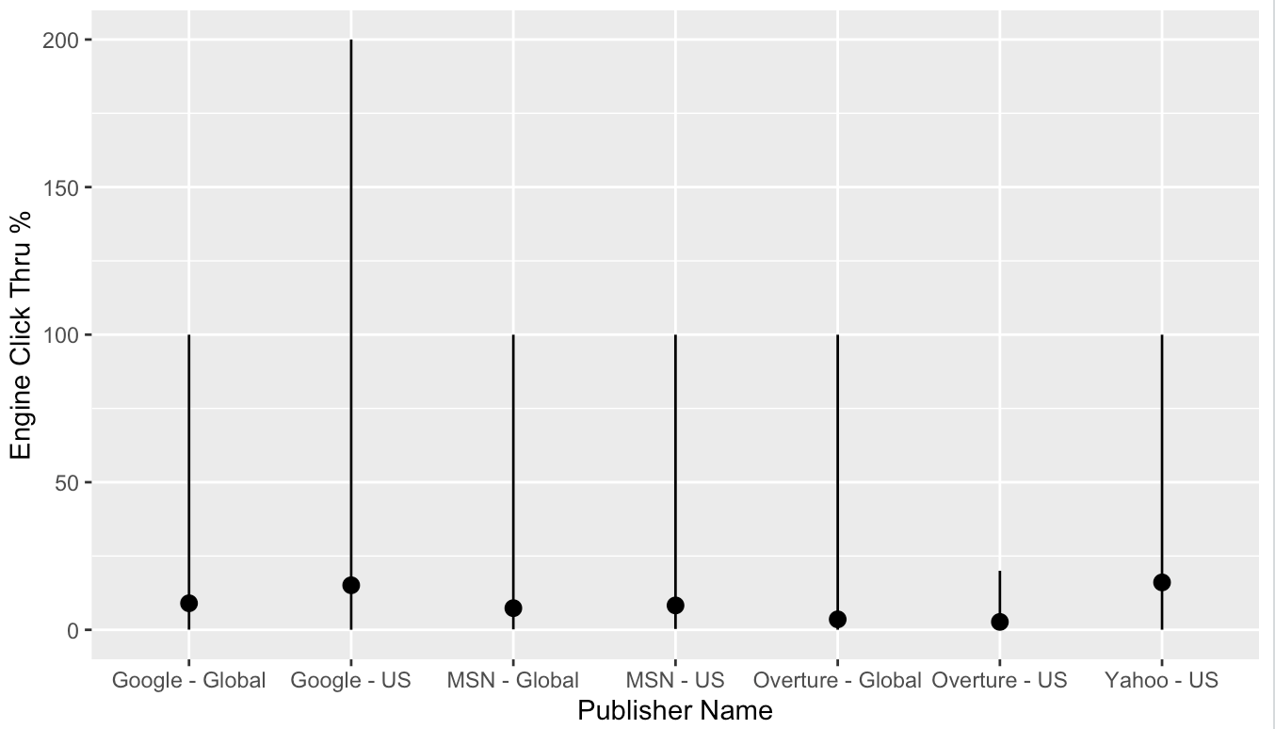
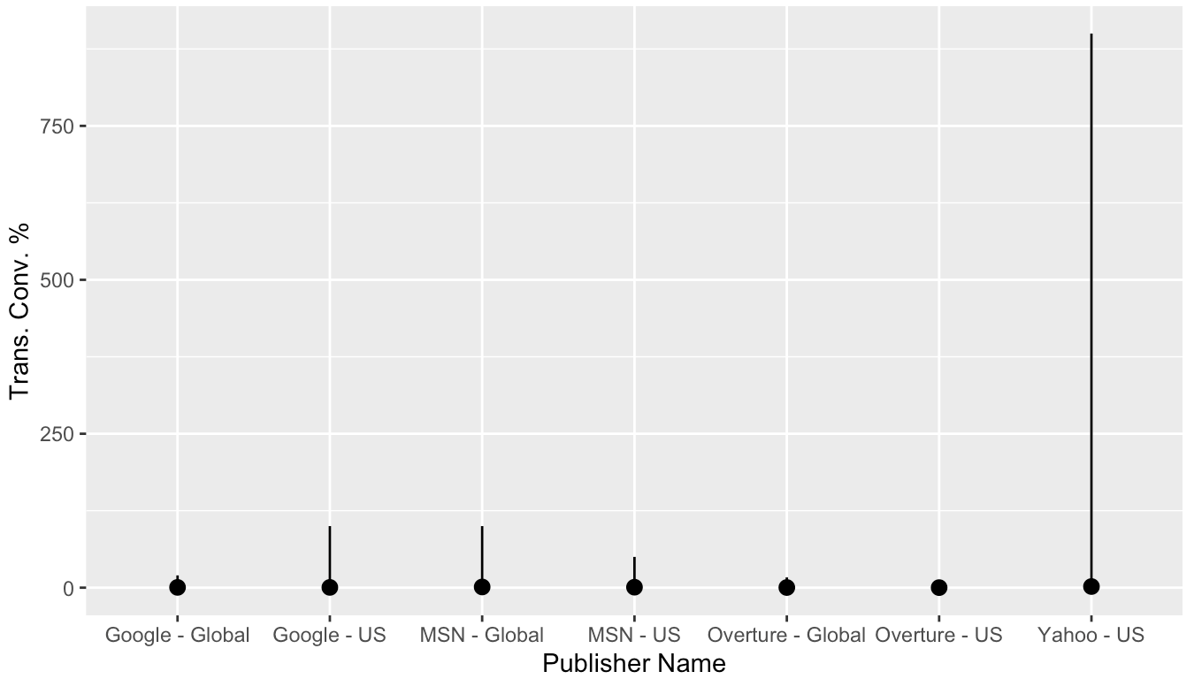
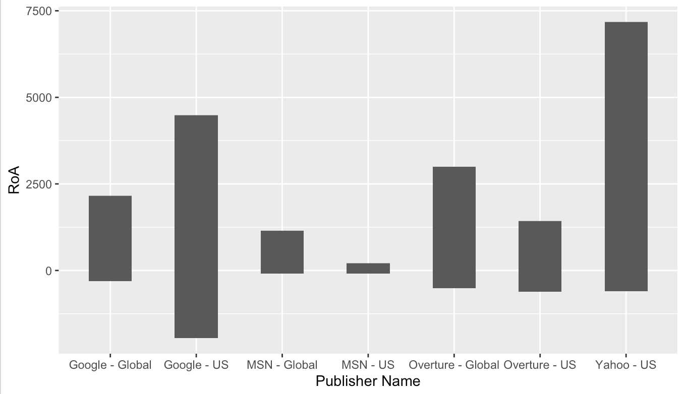
Business Insights
ROAD BRIDGES
Marketing Campaign Analysis
SUBWAY STATIONS
Google-US and Yahoo-US have the higher average “Engine Click Through Rate”
Yahoo-US, Google-US and MSN-Global performs better in “Trans.Conv.%”.
Yahoo-US and Google-US have the higher RoA.
Despite being red, Mars is a cold place, not hot. It’s full of iron oxide dust, which gives the planet its reddish cast
Yes, Saturn is the ringed one. This planet is a gas giant, and it’s composed mostly of hydrogen and helium
Notes:
Lets now go ahead and take a deep look in our analysis.
In terms of Click Trough Rate, we can see that Google and Yahoo operating in the US have the best performance. This means people click more in this websites than the others.
This can also be reflected in the conversion rate and the return on advertising when the purchase is completed.

Slide 8
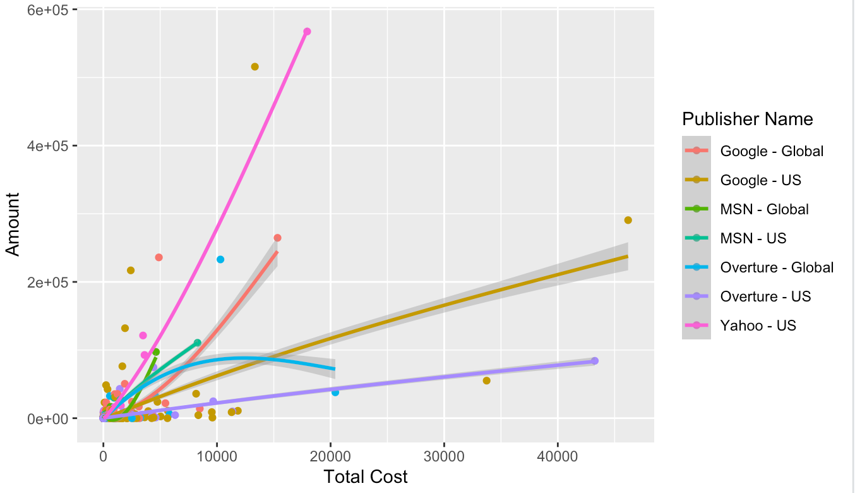

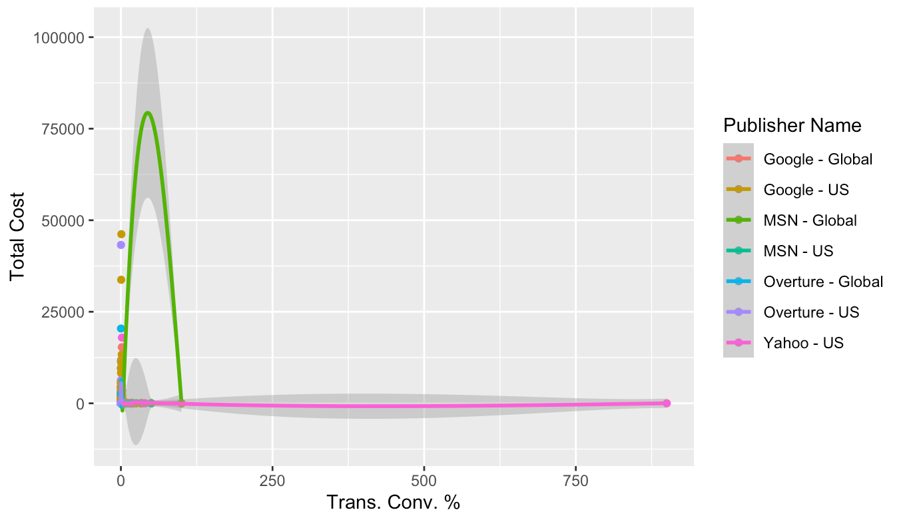
ROAD BRIDGES
Publisher Analysis
SUBWAY STATIONS
Business Insights
Despite being red, Mars is a cold place, not hot. It’s full of iron oxide dust, which gives the planet its reddish cast
Yes, Saturn is the ringed one. This planet is a gas giant, and it’s composed mostly of hydrogen and helium
Yahoo - US has the highest cost performance. Followed by Google-Global and Google US.
MSN-Global has the highest “Total Cost” and lower “Trans.Conv. Rate”.
Yahoo-US has the lowest “Total Cost” and highest “Trans.Conv. Rate”.
Notes:
In terms of cost, we can see that Yahoo - US has the lowest cost and the highest conversion rate which means it is the one with the highest ROA.
Also Google has a good performance in terms of ROA even though it is not that cost efficient.

Slide 9
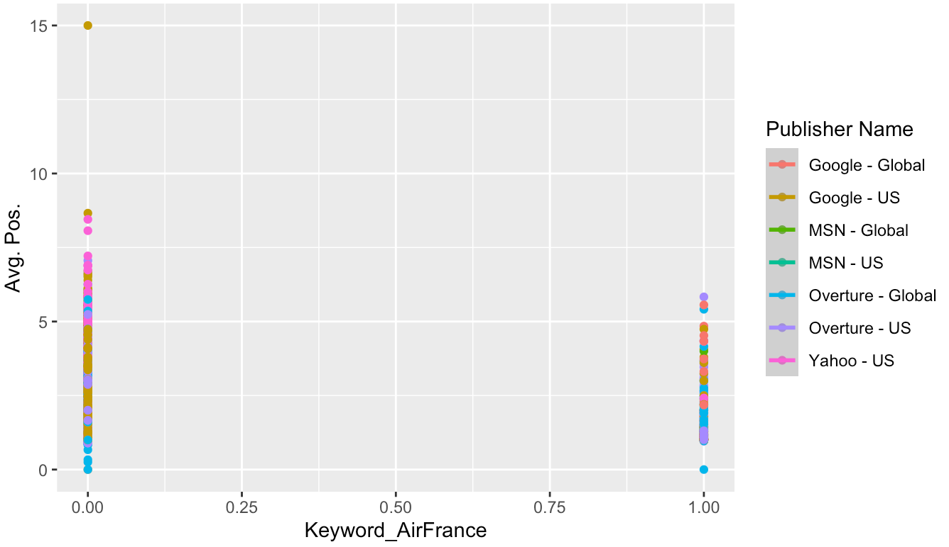
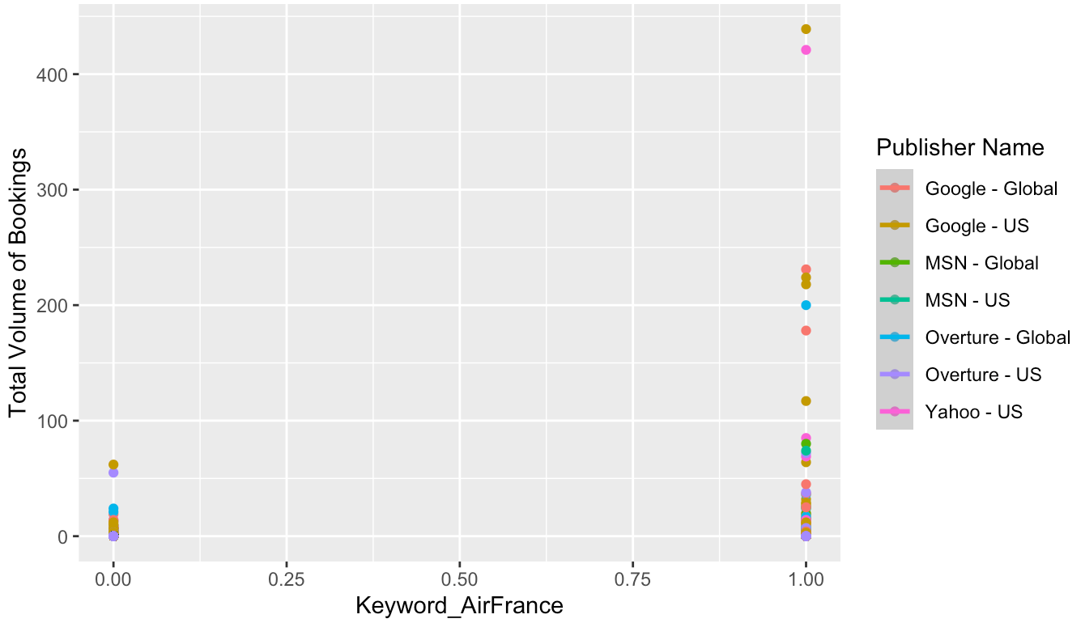
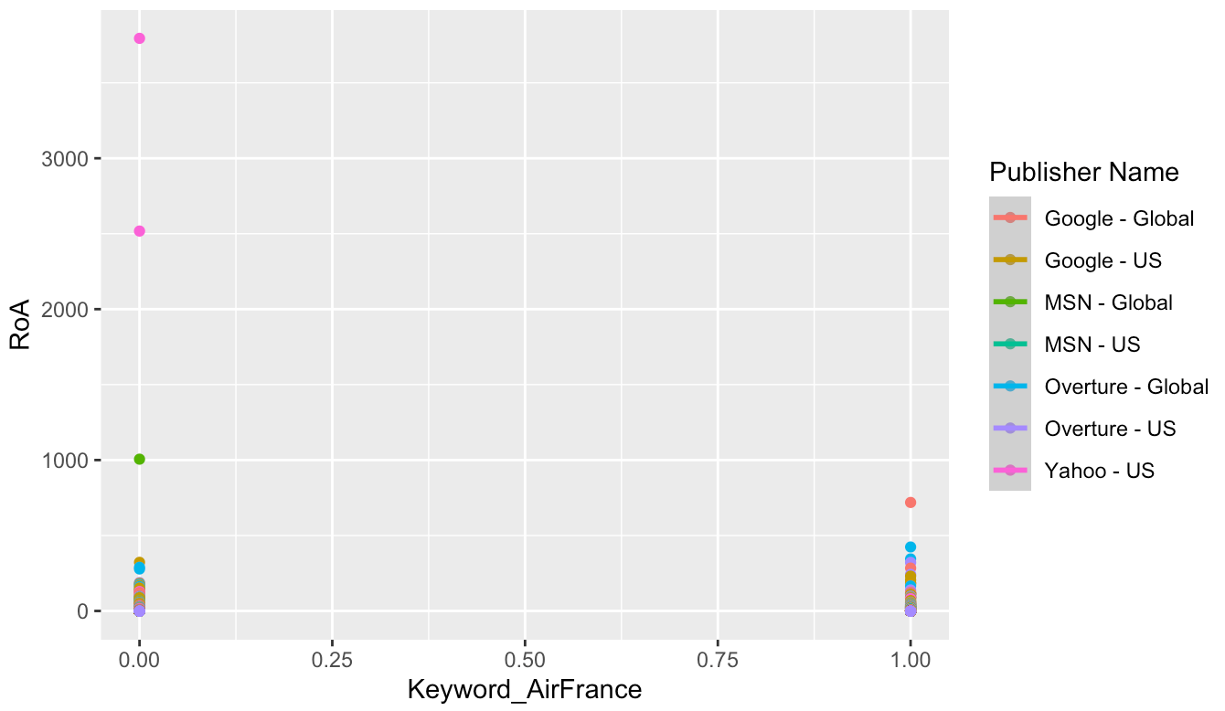
ROAD BRIDGES
Keyword Analysis
Business Insights
Despite being red, Mars is a cold place, not hot. It’s full of iron oxide dust, which gives the planet its reddish cast
The use of branded keyword is relevant on the performance of every search engine since it increases the chance of a better position in the result, greater ROA and higher booking rate.
Notes:
0 = Unbranded keywords
1 = Branded keywords
With this charts, we can see that the use of branded keyword is relevant on the performance of every search engine
since it increases the chance of a better position in the search result, greater ROA and higher booking rate.

Slide 10
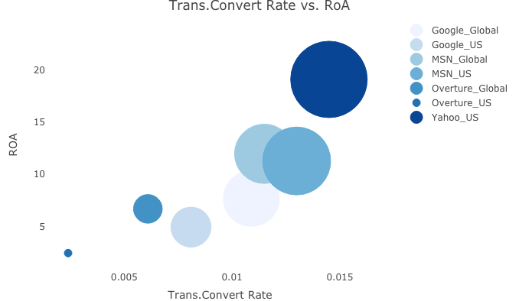
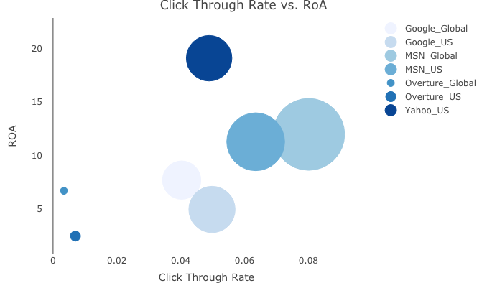
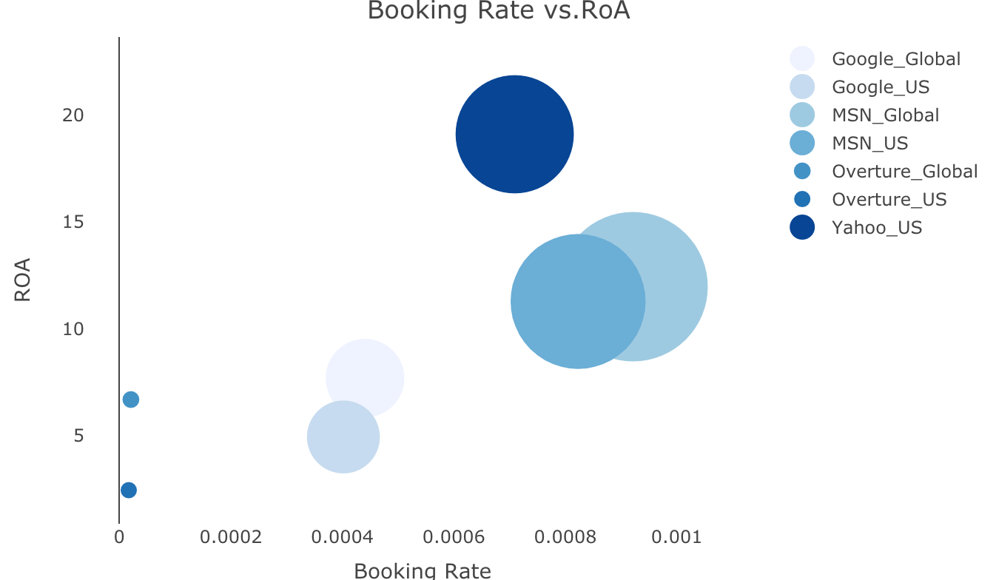
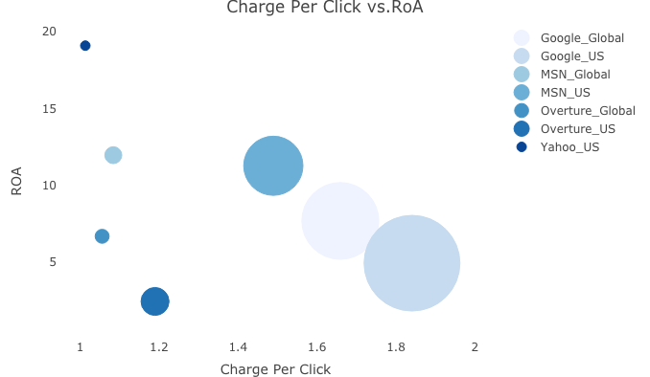
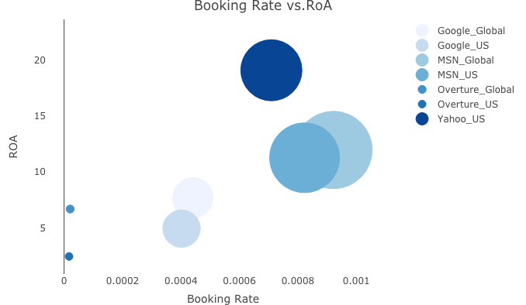
RoA Analysis
Business Insights
Overall, Yahoo-US performs best in RoA
Overall, Overture-US performs worst in RoA
Notes:
In this charts we can clearly see which publishers perform the best in terms of ROA.
As mentioned before, Yahoo has the best performance since it is the one with the greatest booking rate and the highest conversion rate.
Another important thing to highlight here is how Overture is the least performing publisher in every KPI. This means it is basically a waste of resources since it has almost zero ROA and very low Booking rate.

Slide 11
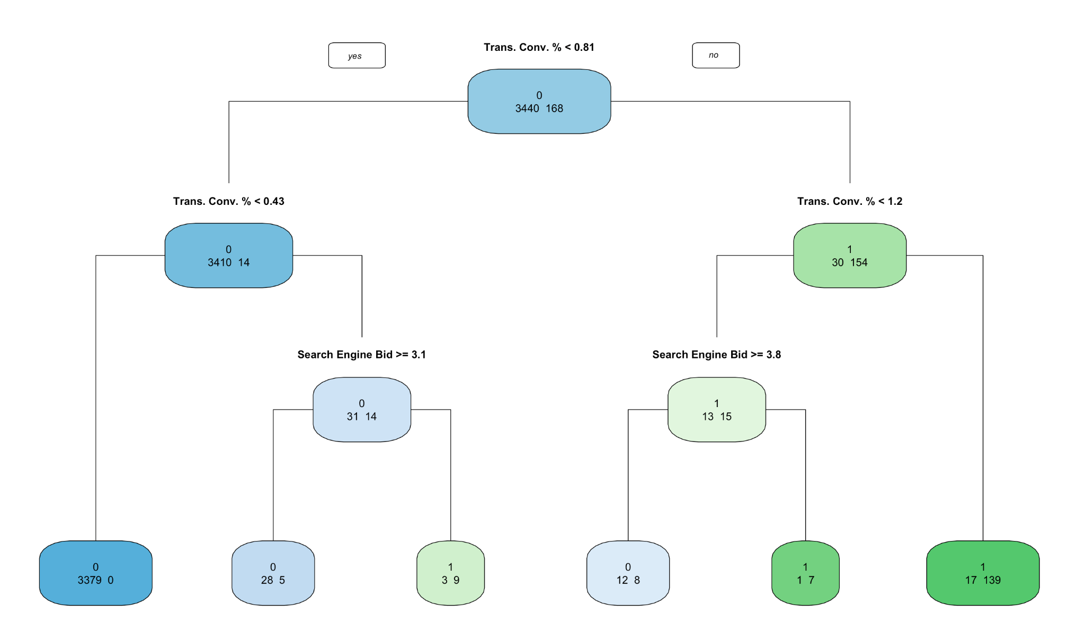
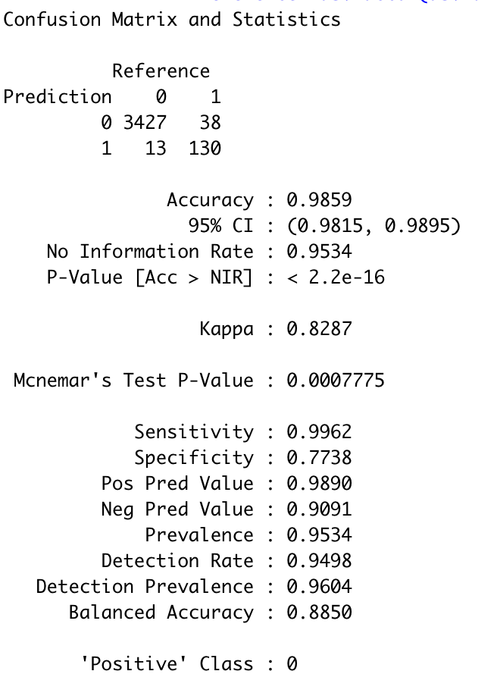
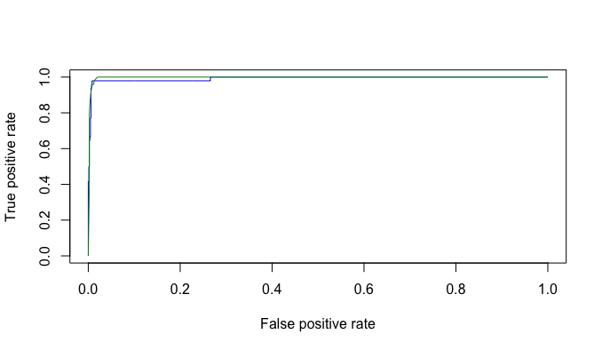
Predictive Analysis
Business Insights
Business Success (ROA >=1) Conditions
Tran.Conv. % > 120% and Search Engine Bid < $3.8
Trans. Conv. % is between 43% and 81% with Search Engine Bid < $3.1
Business Failure (ROA < 1) Conditions
Trans. Conv. % < 43% and Search Engine Bid >= $3.1
Trans. Conv. % > 120% and Search Engine Bid >= $3.8
Notes:
Business Success (ROA >=1) Conditions
Tran.Conv. % > 120% and Search Engine Bid < $3.8
Trans. Conv. % is between 43% and 81% with Search Engine Bid < $3.1
Business Failure (ROA < 1) Conditions
Trans. Conv. % < 43% and Search Engine Bid >= $3.1
Trans. Conv. % > 120% and Search Engine Bid >= $3.8

Slide 12
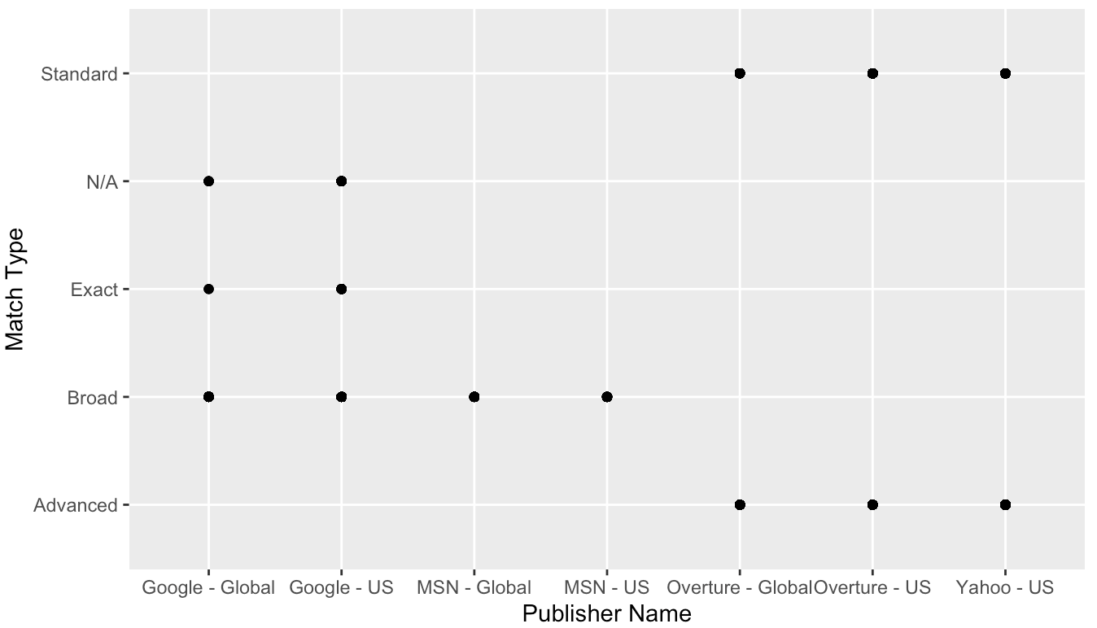
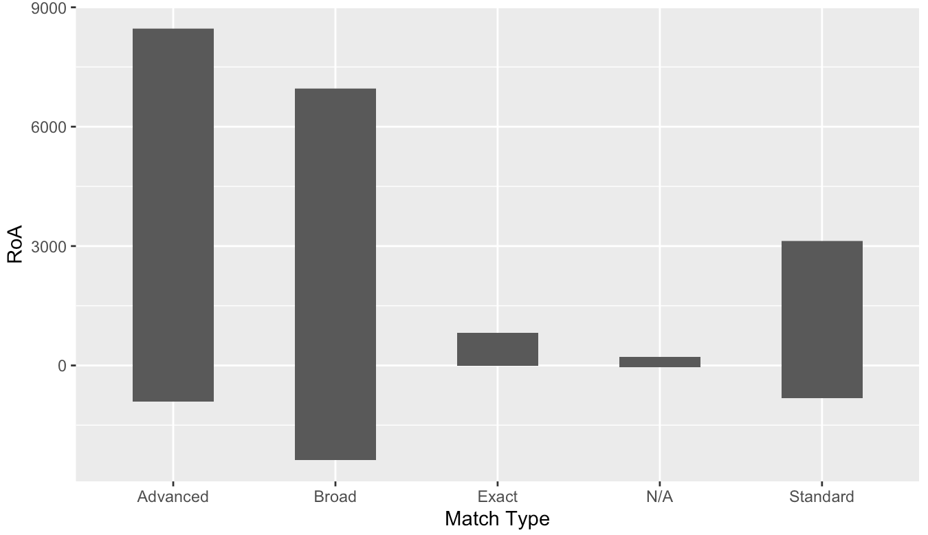
Recommendation 1
Increment the budget in keyword match types of “Advanced” and “Broad” which are provided by Yahoo-US and Google-US
Notes:
Keyword with the match type of "Advance", "Broad", and "Standard" have higher RoA.
Yahoo-US and Google can offer all these three keyword match types business.

Slide 13
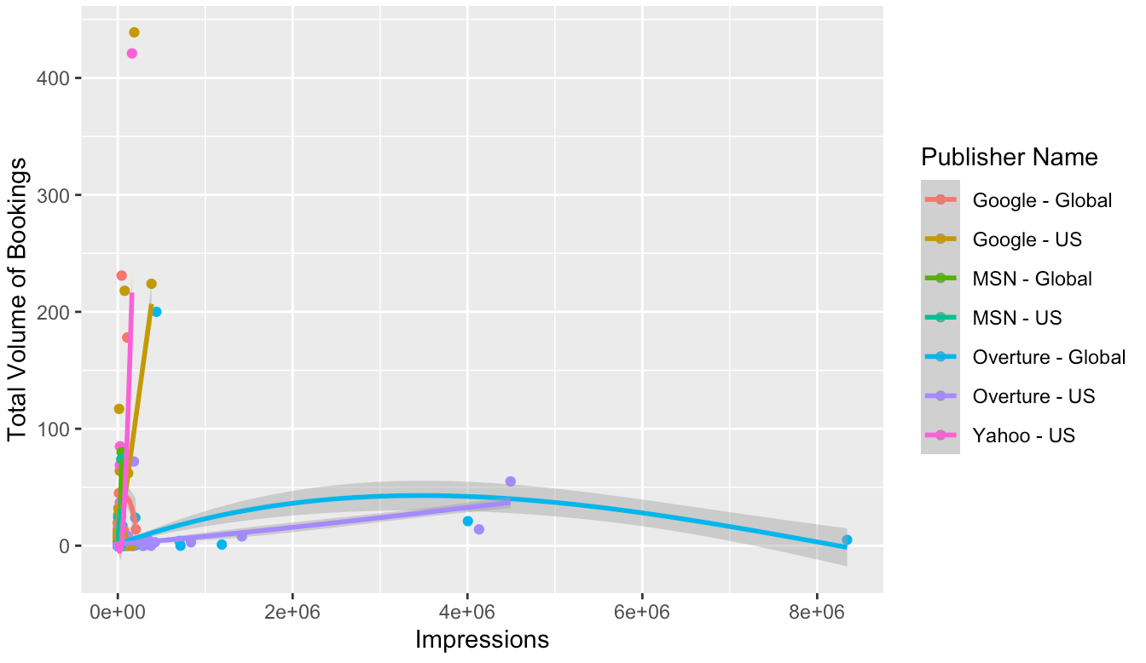
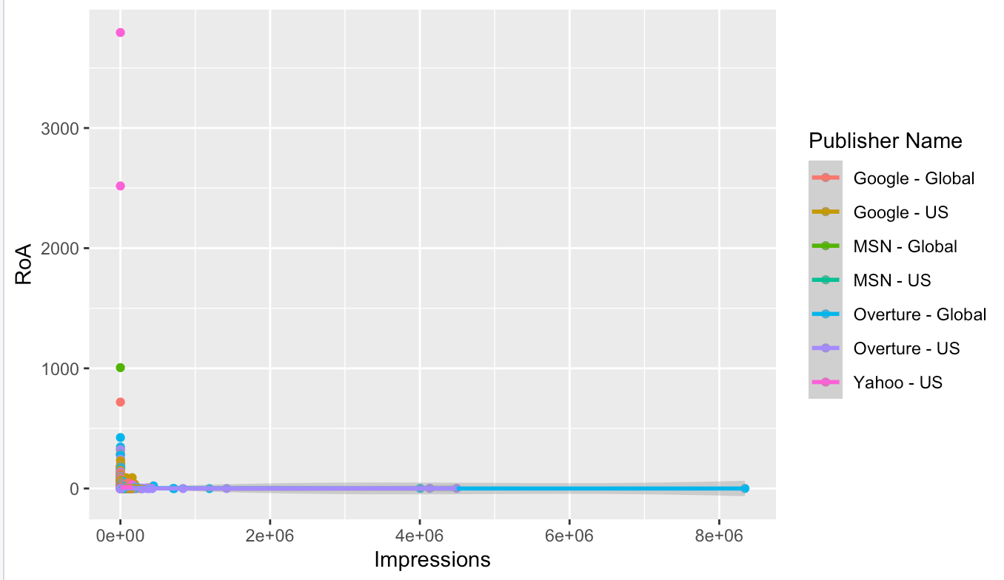
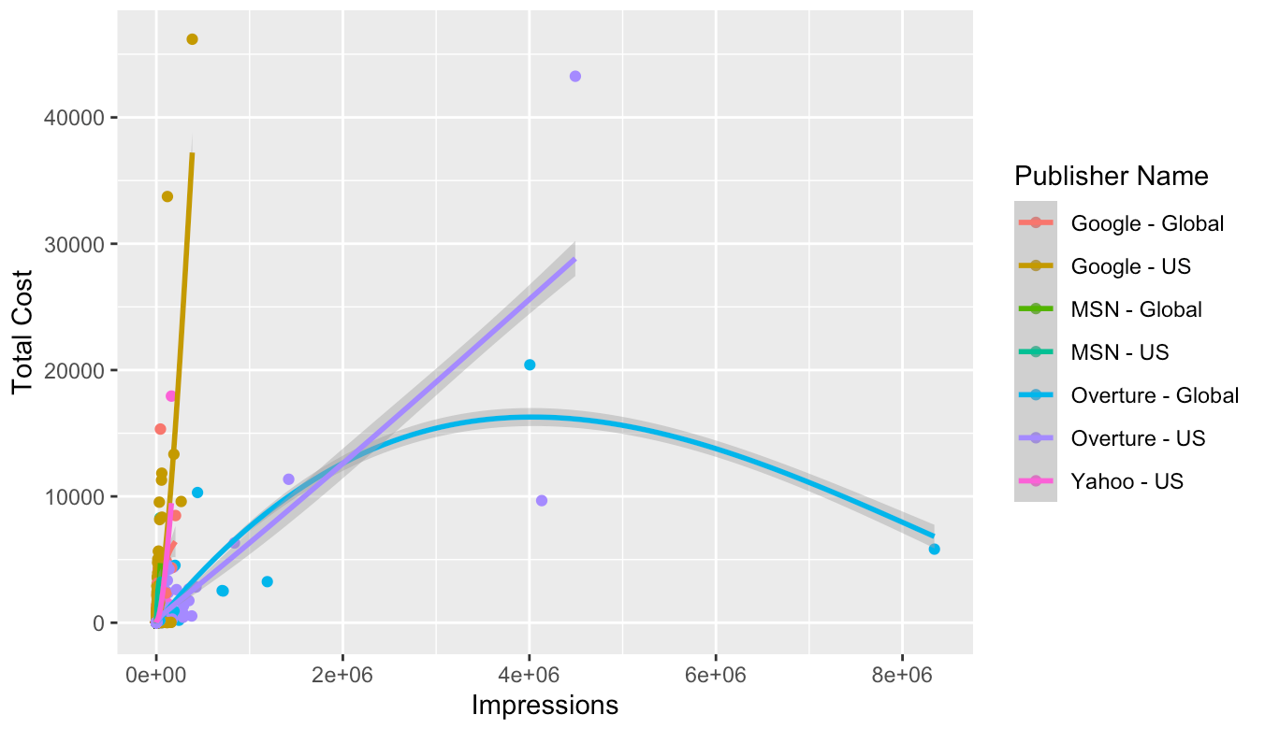
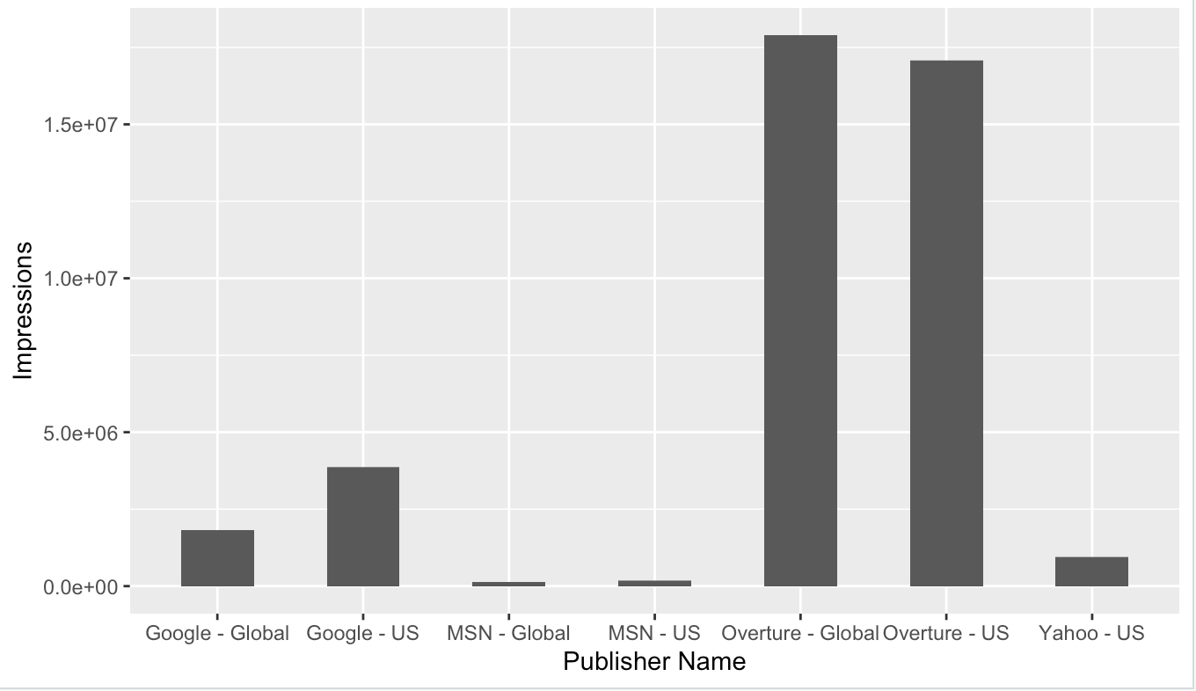
Recommendation 2 & 3
Reduce budget in “Impressions” and relocate it from Overture to Yahoo-US and Google-US (the best performing).
Notes:
Overture has a large number of impressions that are not being translated into bookings or ROA.
Therefore the budget from this publisher should be relocated to the other Search engines that have a better performance.

Slide 14
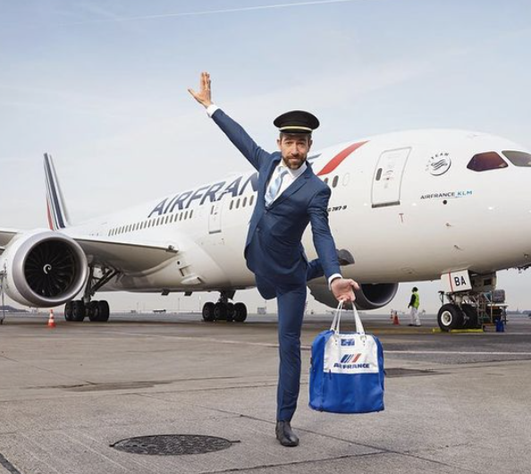
Recommendations & Next Steps
Invest advertising budget to Yahoo-US and Google-US in match types of “Advanced” and “Broad” keywords.
Reduce expenses in “Impressions”.
Relocate the budget from Overture to Yahoo-US and Google-US.

Slide 15

Thank You!

Slide 16
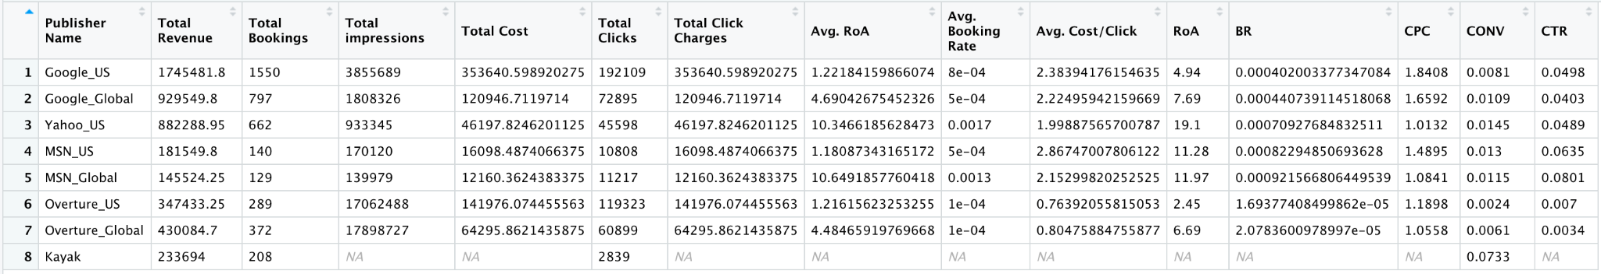
APPENDIX

